Slide 1

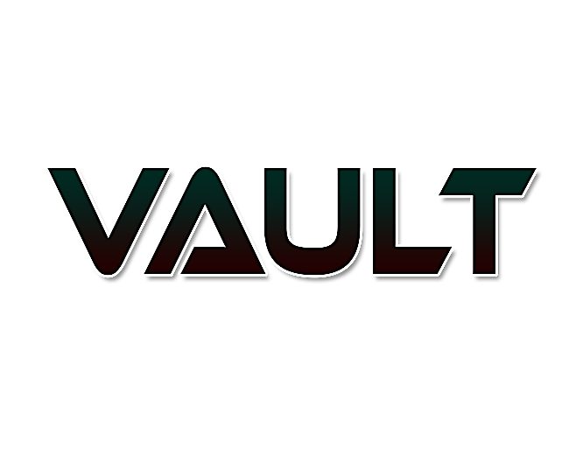
A SHARED DISTRIBUTED AND REDUNDANT STORAGE SOLUTION

Slide 2




Team
T.R.N.R.
Peiris
K.V.A. Sachintha
Undergraduate at SLIIT
Undergraduate at SLIIT
Following a degree program in cyber security
Following a degree program in cyber security
B.A. Ganegoda
W.M.U.K.M.T. Bandara
Undergraduate at SLIIT
Undergraduate at SLIIT
Following a degree program in cyber security
Following a degree program in cyber security

Slide 3
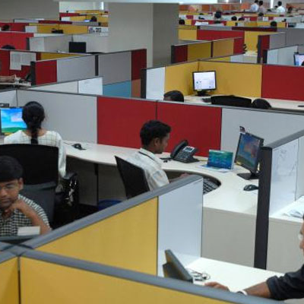
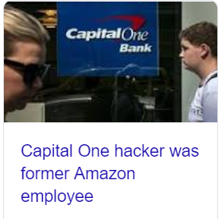
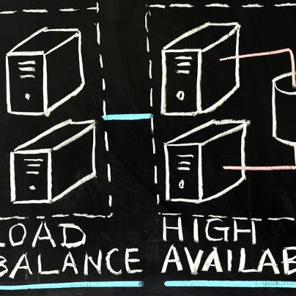


Problems
Wastage of Storage
Security
Availability
Inflexible Contracts
Recurring Cost
Corporations that use thousands of workstations for their employees have hundreds of terabytes of unused free space in their hard drives
Can you ensure your data’s privacy??
AWS multi AZ (Availability Zone) failure (2017)
Network link failures
Network edge layer failures
Your data is PHYSICALLY elsewhere!
Storage subscriptions G-Suite 5 USD per user per month
Network infrastructure costs

Slide 4


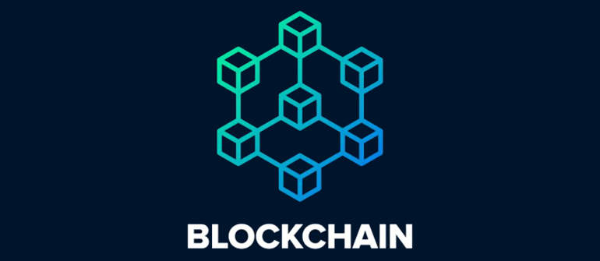
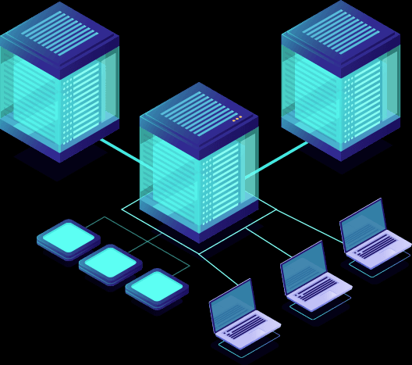

Solution
Shared
Distributed
Redundant
Secure
Responsibility for maintaining consistency within the “swarm” is shared.
Blockchain technology and Machine Learning technologies will be used
Uses Reed Solomon Erasure codes to ensure maximum redundancy at N/2 peer failures.
Data is encrypted locally before it’s pushed to the “swarm”
A shared distributed and redundant storage solution

Slide 5
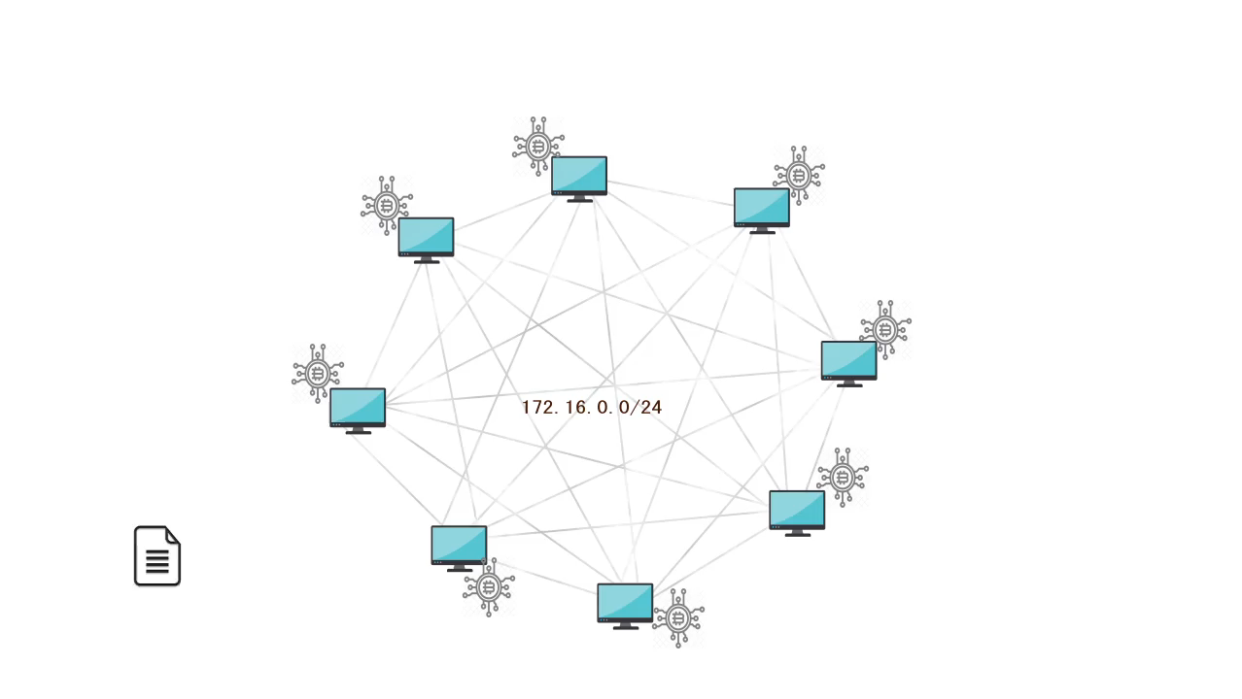
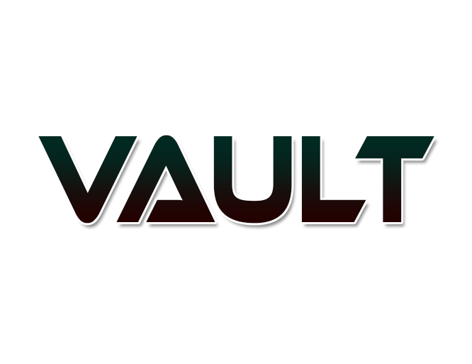
Product
Many of the companies and organizations are prone to use cloud solutions and datacenters as their storage solution. But we are proposing a local solution or a local data storage solution using existing system/network infrastructure that will eventually render cloud storage solutions obsolete.

Slide 6
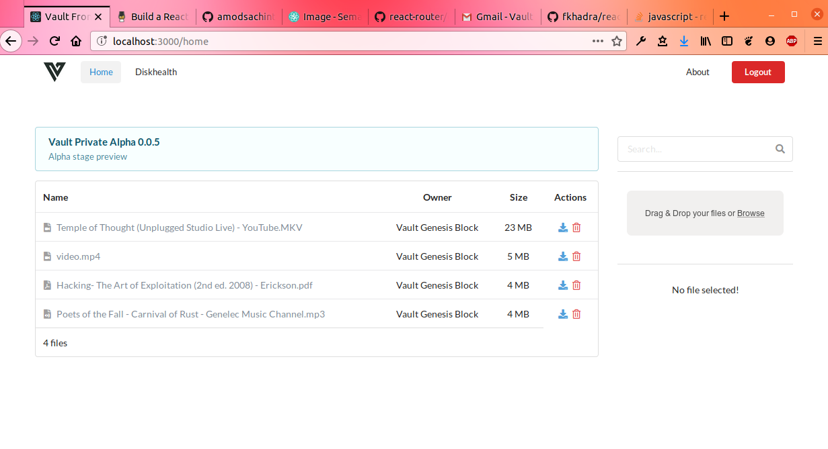
Digital Product
Secure your data in a redundant and distributed manner by sing emerging technologies
Other benefits include
Vault is developed on the NodeJS runtime.
This means that Vault is operating system agnostic.
Any Windows, Linux or OSX user can easily setup their PC to be part of a Vault peer to peer network regardless of the underlying architecture differences between nodes/peers.

Slide 7

Technologies
Powerful platform built with the
use of emerging technologies

Slide 8
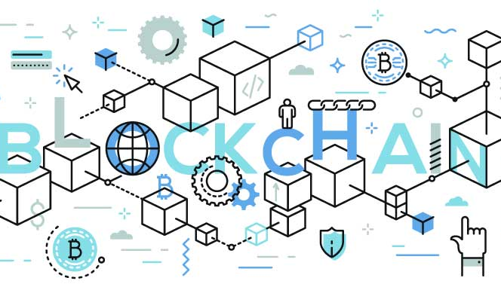
BLOCKCHAIN TECHNOLOGY
The blocks in the blockchain contain information about the file, fragment data, file metadata, fragment locations, timestamps, and most importantly, hashes.
Vault’s blockchain, known hereafter as “Fragchain”, uses SHA-256 hashing to assure that no collisions occur when a block is generated.
Furthermore, it uses a Merkele-DAG to further ensure integrity of fragment data that is stored in the chain.
This blockchain will establish an immutable timeline of how files were accessed.
It will also establish nonrepudiation such that as user won’t be able to deny an action done on their behalf.
Enhance security. (Protect from tampering)

Slide 9
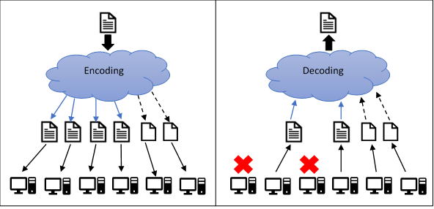
IMPLEMENTING REDUNDANCY
Files will be segmented into 4 pieces plus 2 parity files.
Then the details will be stored inside the blockchain
Then those files will be distributed through the network.
When recreating a file even though two nodes are down file can be recreated using parity files.
Reduce space needed for backups

Slide 10

INTELLIGENT RESOURCE ALLOCATION THROUGH A CUSTOM ML MODEL
The following metrics are used to generate a predictive model to determine which nodes are selected when a file is processed
Node uptime
Link bandwidth
Available free space
Managing virtual storage pool

Slide 11


Business Model
There is an opportunity for success
Phase 1
Phase 2
Organizational implementation
Mobile Implementation

Slide 12


Market Opportunity Phase 1
Organizational implementation)
This phase will enable us to implement the product to organizations such as universities, large scale corporations.
This will be implemented on a billed per node basis.
The profit of this phase can be used to trigger the next phase of the project. Which is the mobile implementation.

Slide 13
Market Opportunity Phase 2
Mobile implementation)
The next phase of this product is the mobile application.
This will be released to the general public.
The users of this mobile application will be able to share their space of their devices as a contribution and will receive a space to store data just like the phase one product.
The mobile application will have a point base system which the users can use that point system to accumulate more storage space. workstation devices.

Slide 14
ECONOMICAL IMPACT
Higher security through proven encrypted and sharding technologies.
Reduce third party involvement.
Wastage on dedicated storages are prevented.
Prevent data duplication
Intelligent resource allocation.

Slide 15
Social impact
Strives to reduce the organizations carbon footprint.
Minimizes law suits caused by unsafe data handling.
“
”
“
”
Minimizes data leakage.
“
”

Slide 16

Summary
Vault was developed with user experience as a prominent priority.
It is easy to install, setup and run.
It provides a clean minimalistic web interface developed using reusable React Components thus extending the familiar feeling of using a cloud storage provider such as Google’s Drive.

Slide 17

Demonstration

Slide 19




Thank You
Vault.
Niran Ramesh Peiris
+0 75 087 9005
peiris1996@gmail.com

Slide 20

Questions ?????

